Slide 1
End-to-End Retail Performance and Behavioral Analytics
Presented by A.AKSHAI

Slide 2
OVERVIEW
Over the last few years, RetailNova has experienced rapid growth in online orders, especially during the pandemic. However, recent quarters have seen increased product returns, customer churn, and declining profitability in certain regions and product categories. To maintain its market position and plan for the next growth phase, RetailNova’s leadership wants to become more data-driven in its decision-making.
Business Goals:
Identify key sales trends and anomalies
Understand customer behavior and segmentation
Optimize product performance and inventory
Improve store and regional profitability
Support decision-making through data visualization and reporting

Slide 3
METHODOLOGY
Data Cleaning & EDA :
Cleaning the raw csv files, adding new columns, changing the datatypes and run the basic EDA using python.
SQL Analysis :
After cleaning the csv files, create a Database, import the cleaned data and solve different business questions.
Data Visualization :
Creating some interactive dashboard using Power BI through the cleaned datasets.

Slide 4
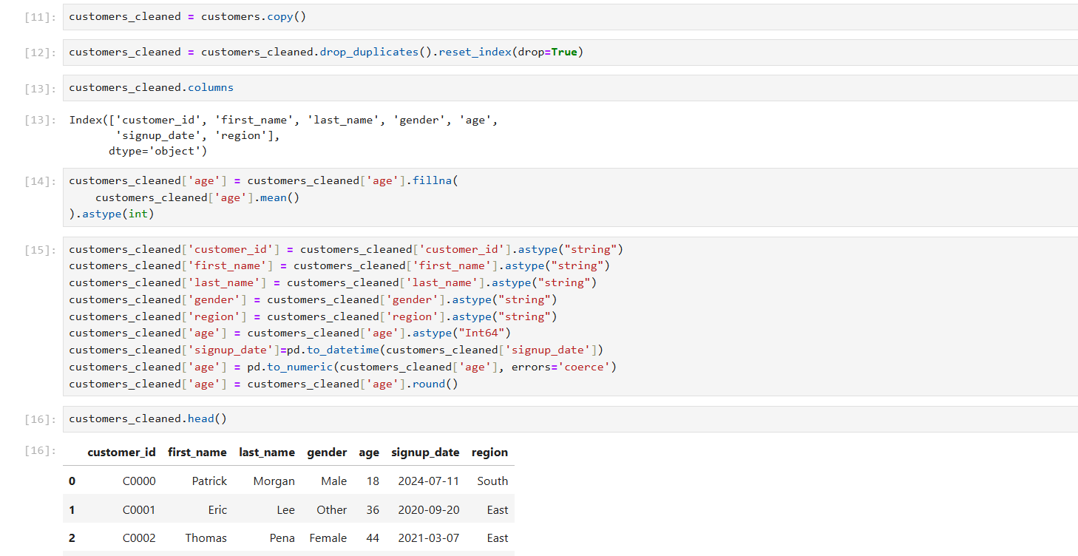

Slide 5
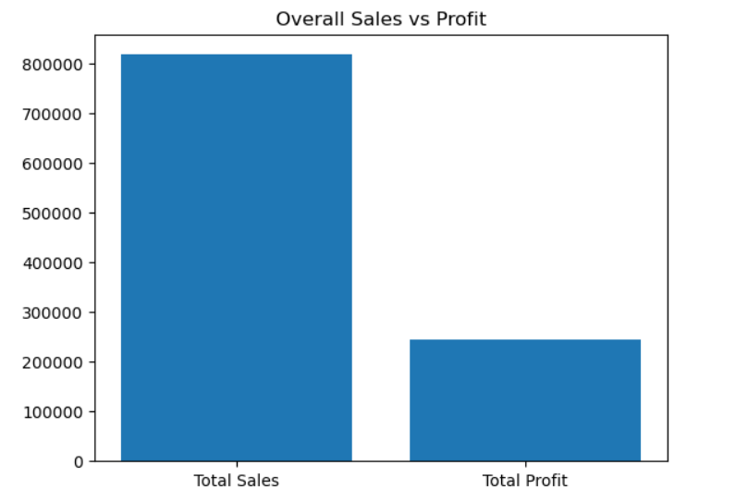

Slide 6
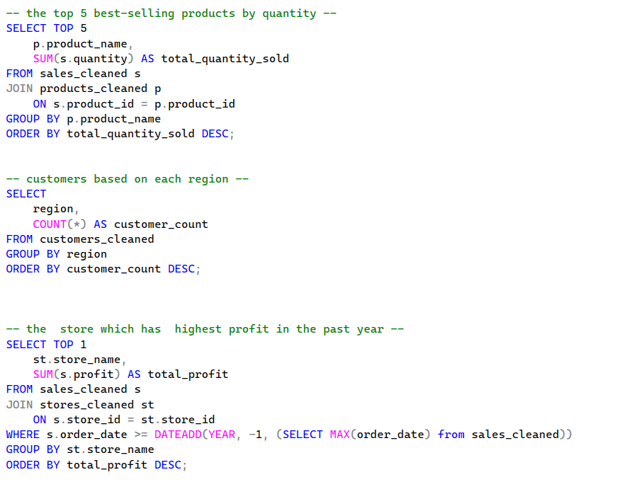

Slide 7
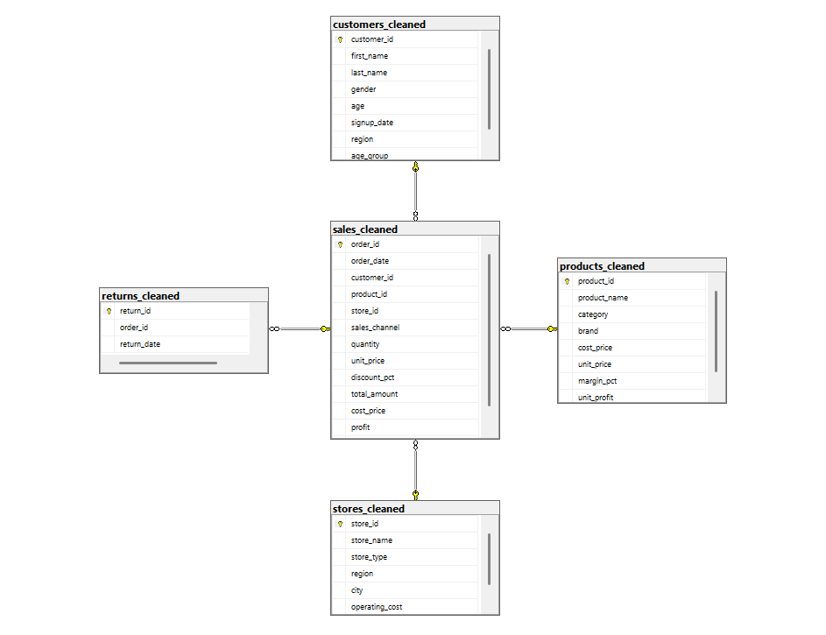

Slide 8
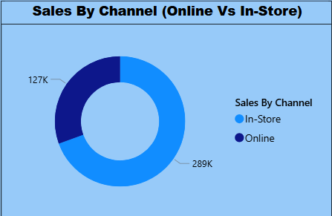
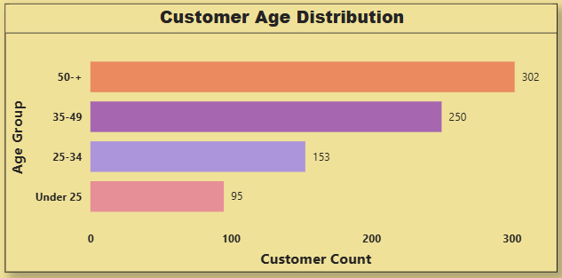
This Chart Shows:
In-store sales dominate at 289K, more than double the 127K generated from online sales.
This Chart indicates :
Customer numbers are highest in the 50+ age group and after that 35-49 age group has more sales .
Younger (Under 25) age groups make up the smallest share of customers.

Slide 9
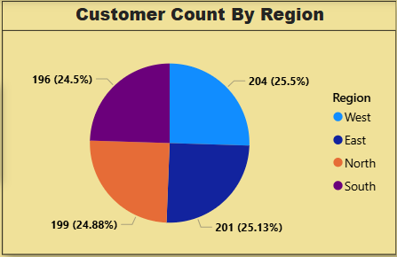
Customer distribution is almost equal across all regions, with each contributing around 25% of total customers.
The West leads slightly with 204 customers, while the South is the lowest at 196, showing a well-balanced market.

Slide 10
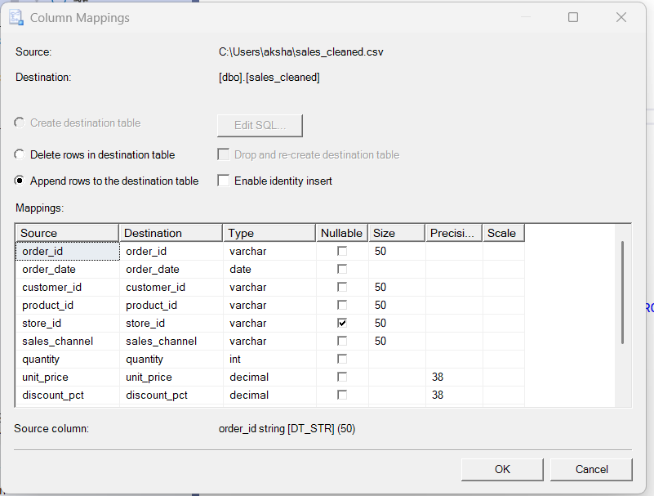
CHALLENGES FACED
During the process of importing the cleaned CSV files into SQL Server and establishing relational constraints, repeated errors were encountered while creating the foreign key on the store_id column in the sales_cleaned table.
Because of this issue:
Foreign key creation failed multiple times
Relationships between the sales_cleaned and stores_cleaned tables could not be established
SQL Server raised constraint conflict errors, preventing schema finalization

Slide 11
Root Cause
Although the business logic allows store_id to be nullable for online sales, missing values had been replaced with a placeholder ('-') during the data cleaning phase in Python.
When importing the data into SQL Server:
SQL Server treated '-' as a valid string value rather than a missing value
These placeholder values did not exist in the stores_cleaned table
As a result, SQL Server rejected the foreign key constraint due to referential integrity violations

Slide 12

Resolution
To resolve the issue:
The placeholder values ('-') in the store_id column were converted back to NULL directly within SQL Server
This aligned the data with the business requirement that online sales do not have an associated store
Once the column correctly contained NULL values instead of invalid references, the foreign key constraint was successfully created between sales_cleaned.store_id and stores_cleaned.store_id

Slide 13
CONCLUSION
The visualizations made it easier to identify which areas are strong and where improvements can be made.
Overall, the reports provided a meaningful overview of the dataset and supported data-driven decision making in a simple and effective way.
The analysis reveals that data-driven decision-making is essential for optimizing sales Trends, customer behavior, product performance and improves store and regional profitability.

